Slide 1
USMC Robotics Club 2017
2nd class of Arduino Module

Slide 2
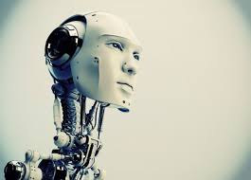
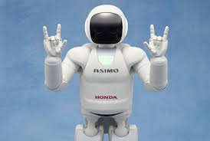
What defines a robot?
Despite to common believe, robots do not necessary look like what we see in movies.
In definition, robots are machines are able to act accordingly to changes in the environment and make decisions, that includes cars, air-conditioners and even your rice-cooker!!

Slide 3
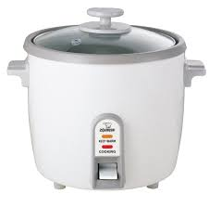
My rice cooker is a robot??
Technically yes, that is because your rice cooker has buttons and specific sensors to make decisions on what type of rice it should cook, how long it should cook them etc.
How Skynet’s Grandpa looks like:

Slide 4
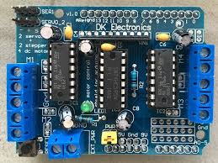
Arduino Motor Shield
In this course, we will be learning how to use a motor-driver to control DC motors to built a simple moving robot.
We will start programming after the presentation since the robot chassis is already built for you.

Slide 5
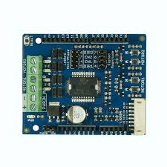
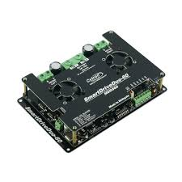
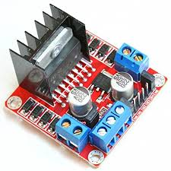
What are motor-drivers?
They are considered as your microcontroller’s workmen, same to workers in a factory, a boss cant run a factory on its on!
A motor-driver protects the microcontrollers from burning since dc motors drive strong currents(some can reach to 60A!) from battery and microcontrollers are built to handle small currents (a few mA).

Slide 6
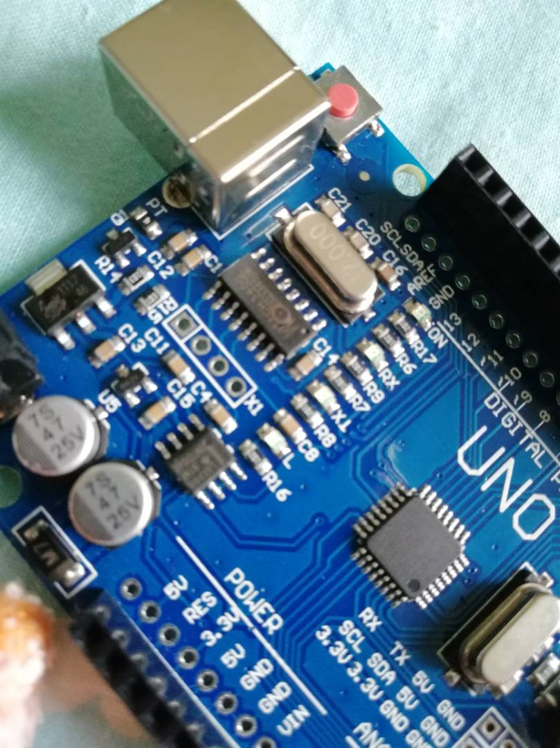
A perfect Example of a burnt Arduino uno:
Can you spot anything wrong in this picture?

Slide 7

Beginning…
Now let us start! In your groups, you are provided with an Arduino UNO R3 module + DK electronics motor driver + Robot Chasis to work on.
Further instructions will be provided.
Please handle them carefully and responsibly.

Slide 8
Downloading the Arduino software
On your laptops, go to www.arduino.cc.
On the menu bar at the top of the page, click the “Software” button.
On that page, download the latest version of Arduino which is Ver 1.8.5. according to the compatibility of the operating system of your device.
Install the programme and run it when installation is complete.
Further instructions will be given.

Slide 9
References
http://forefront.io/a/beginners-guide-to-arduino/
https://www.arduino.cc/en/Main/Software

